Slide 1
Im²C – Carrying capacity
A report made by Ties Bloemen, Lucas Baas, Daniël Kunenborg and Guido Siers

Slide 2
Introduction
Importance
Method of working

Slide 3
Critical factors
Food
Water
Oxygen
Shelter
Energy
Hospitals, roads and schools

Slide 4
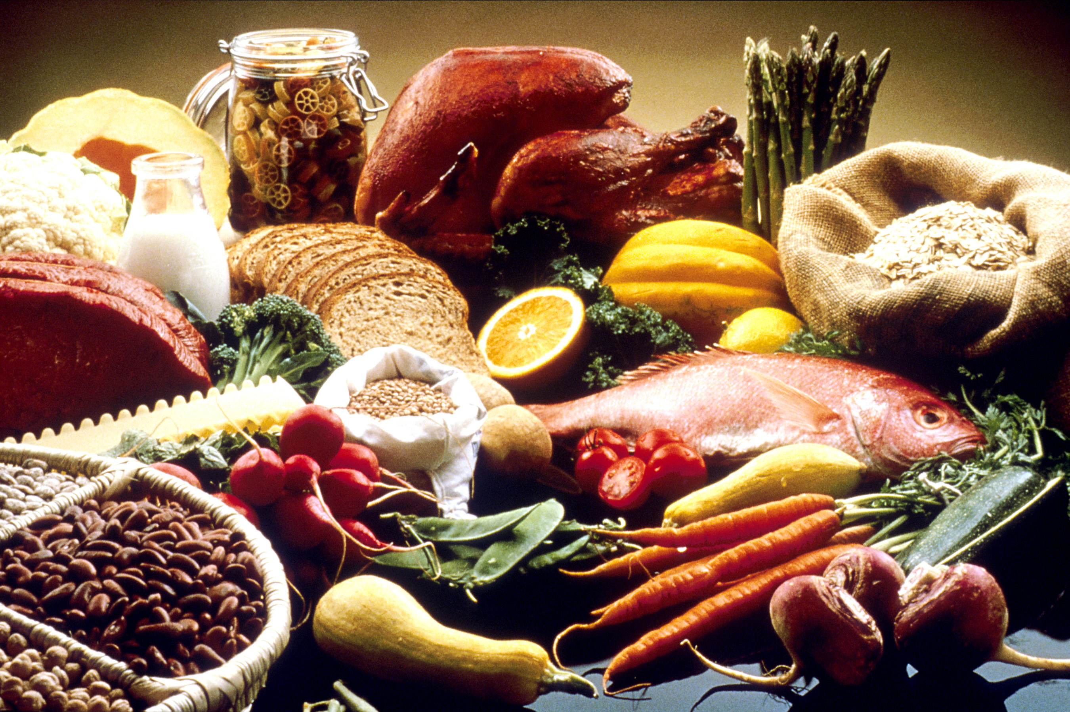
Food

Slide 5

Water
Smaller problem than expected

Slide 6
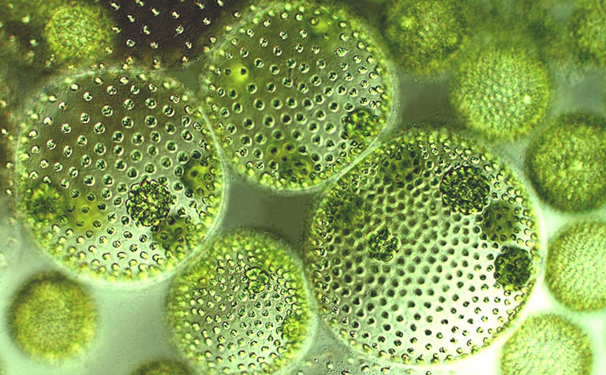
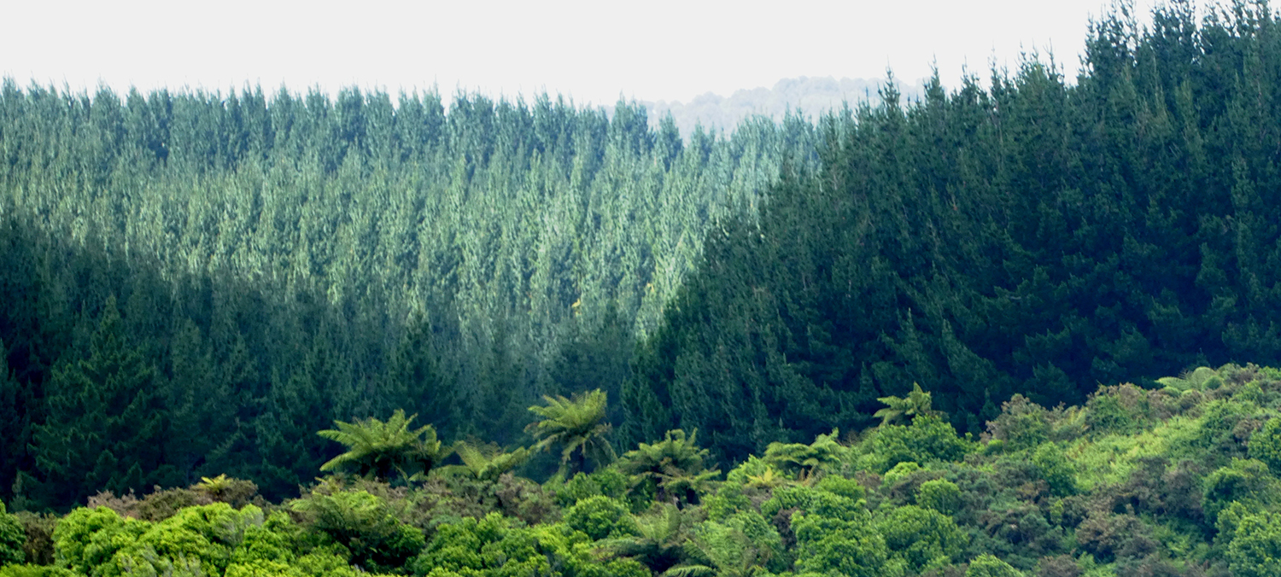
Oxygen
Two sources:
  Algae
  Trees

Slide 7
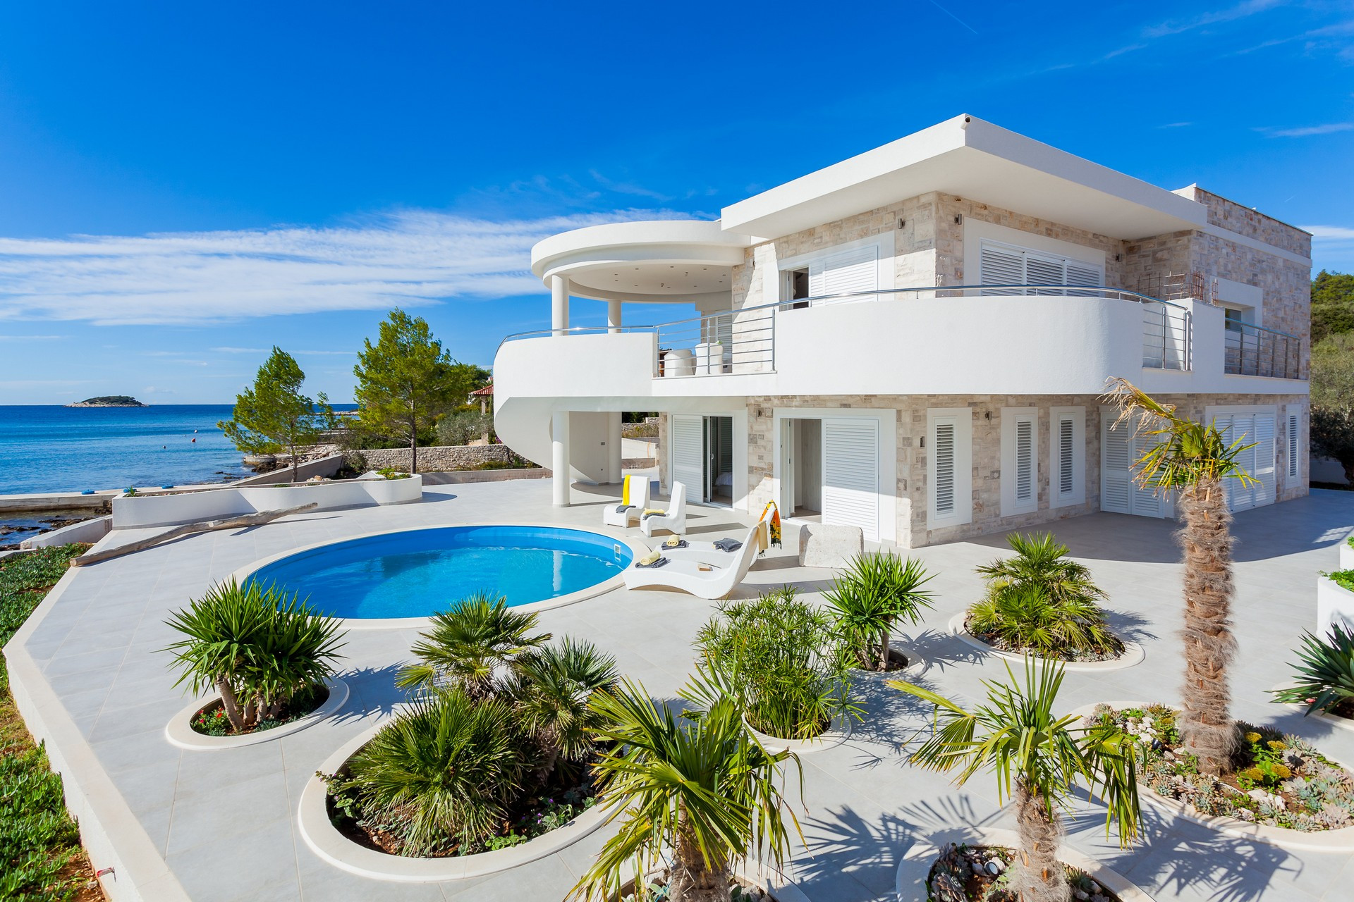
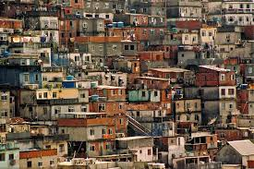
Shelter

Slide 8
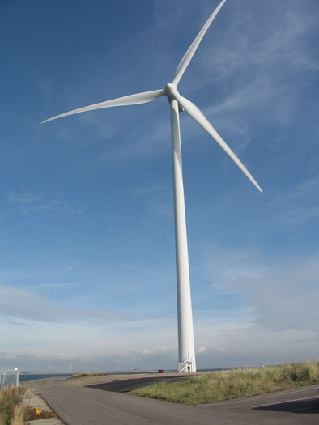
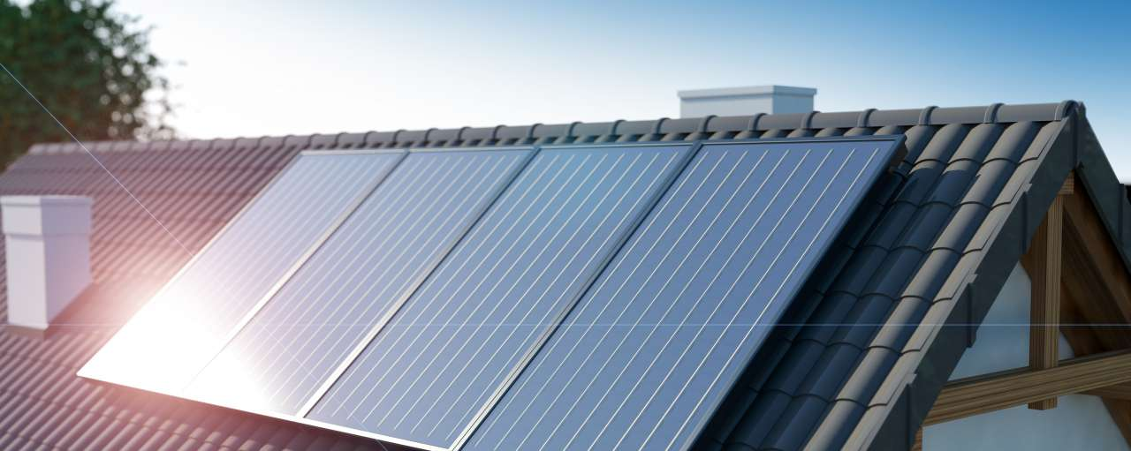
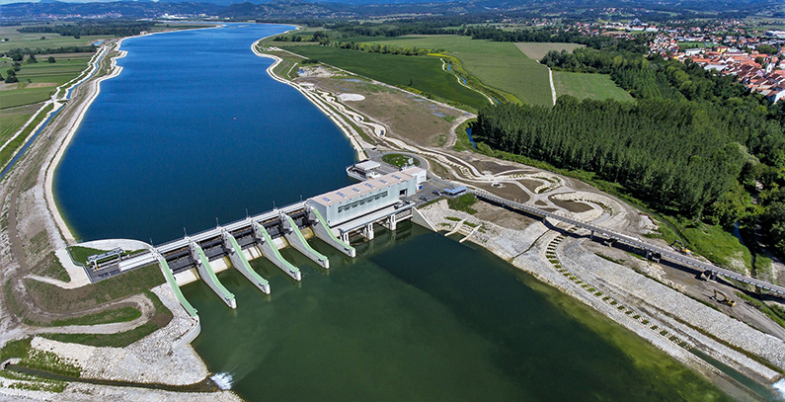
Energy
Only indefinitely sustainable sources
  Solar panels
  Windturbines
  Hydroelectric power stations
unused surface

Slide 9


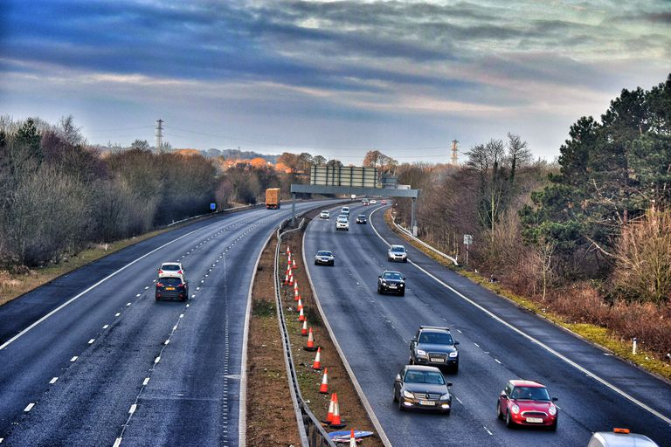
Other variables
Schools
Hospitals
Roads

Slide 10
Model (1)
Idea
Complications
  Oxygen
Solution

Slide 11
Model (2)
x= people that can breathe oxygen produced by algae
Ox= ha earth that x people need
y= people that can breathe oxygen produced by trees
Oy= ha earth that y people need
C= Carrying capacity

Slide 12
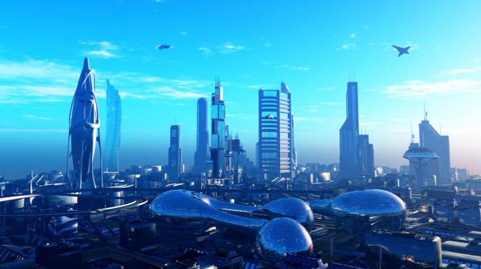
Future

Slide 13
Changes
Stop eating meat, wasting food;
Agricultural flats and living flats;
Lower oxygen ratio;
More algae;
No roads and schools;
Land reclamation.

Slide 14
end
Current Carrying capacity: 8.23 to 9.96 billion
Future carrying capacity: 17.6 to 23.6 billion

